Slide 1
Networks, Graphs, and Matrices
Fall 2017

Slide 2
Social networks, graphs, matrices
Graph Theory
“The Graph”
Matrix Algebra
“The Matrix”
Social Systems
“The Network”

Slide 3
Social networks, graphs, matrices
Graph Theory
“The Graph”
Linkage
Analogy
Matrix Algebra
“The Matrix”
Social Systems
“The Network”
Measurement

Slide 4
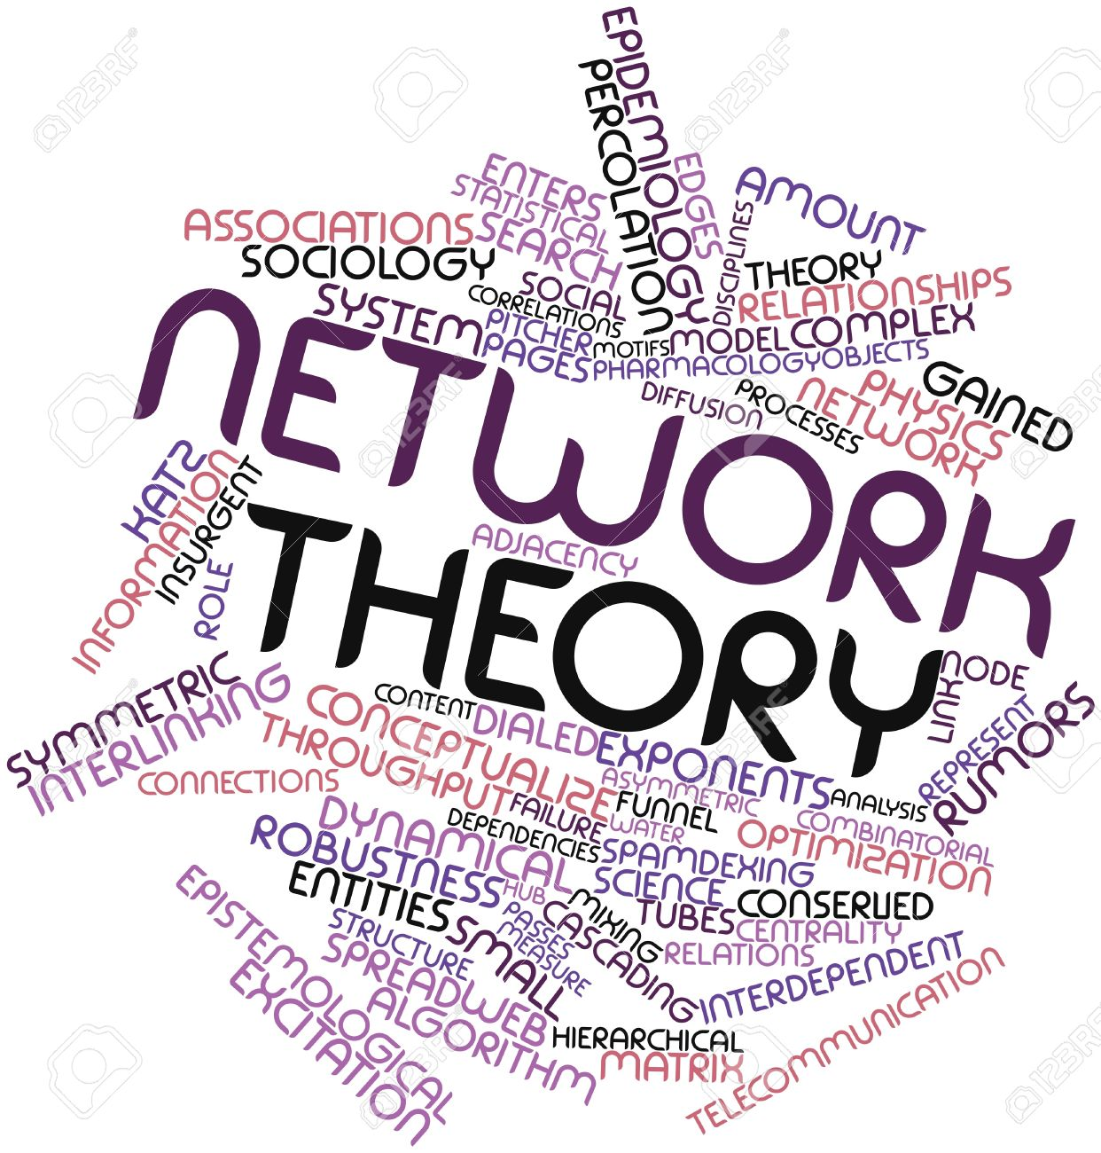
Three ways of talking about "social networks"
Social network theory is a branch of social science
  Allows for the specification of processes occurring in social systems
  Happens in natural language and relies on substantive intuitions
  The relevant "concepts" are by their nature "fuzzy"

Slide 5

Three ways of talking about "social networks"
Social network theory is a branch of social science
  Allows for the specification of processes occurring in social systems :
  Happens in natural language and relies on substantive intuitions
  The relevant "concepts" are by their nature "fuzzy"
Graph theory is a branch of pure mathematics
  Allows for the specification of "analogues" of fuzzy social network concepts stated in natural language in less ambiguous terms

Slide 6

Three ways of talking about "social networks"
Social network theory is a branch of social science
  Allows for the specification of processes occurring in social systems :
  Happens in natural language and relies on substantive intuitions
  The relevant "concepts" are by their nature "fuzzy"
Graph theory is a branch of pure mathematics
  Allows for the specification of "analogues" of fuzzy social network concepts stated in natural language in less ambiguous terms
Matrix algebra is a branch of applied mathematics
  Links to graph to theoretic concepts to allow for calculation and the development of "measures" and metric representations of social network concepts (e.g. “centrality”)

Slide 7
Three ways of talking about "social networks"
Points to keep in mind:
  The mapping from network theory to graph theory can be one to many
    This is not "calculation" or "operationalization"
  Matrices are not direct representations of “social networks”
    Instead, the matrix representation links to the graph theoretic concept
    The graph theoretic concept is an analogue of a structure found in "real" social networks

Slide 8
Three ways of talking about "social networks"
Points to keep in mind:
  The mapping from network theory to graph theory can be one to many
    This is not "calculation" or "operationalization"
  Matrices are not direct representations of “social networks”
    Instead, the matrix representation links to the graph theoretic concept
    The graph theoretic concept is an analogue of a structure found in "real" social networks
  This can lead to a criterion for differentiating "network theory" from "network analysis"
    Network theory consists in the linking of a social process or structure to a mathematical representation
      (e.g. a graph-theoretic representation)

Slide 9
Three ways of talking about "social networks"
Points to keep in mind:
  The mapping from network theory to graph theory can be one to many
    This is not "calculation" or "operationalization"
  Matrices are not direct representations of “social networks”
    Instead, the matrix representation links to the graph theoretic concept
    The graph theoretic concept is an analogue of a structure found in "real" social networks
  This can lead to a criterion for differentiating "network theory" from "network analysis"
    Network Analysis consists in proposing of metric representations of network-theoretic concepts (e.g. matrix-algebra) for purposes of:
      Calculation/Measurement
      Operationalization

Slide 10
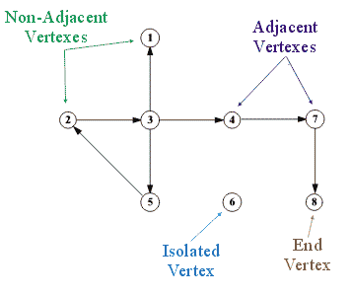
What is a graph?
A graph (G) is an abstract mathematical object (not a picture!)
A graph consists of:
  A set of V vertices V(G)
    {v₁, v₂, v₃, v₄, v₅, v₆, v₇}
      Also called nodes, actors, individuals
  A set of E edges, E(G)
    {v₁v₂, v₂v₃, v₂v₄, v₄v₅, v₄v₆, v₆v₇}
      Also called links, ties, relations
  Such that G = (V, E)

Slide 11
What is a graph?
The cardinality (size) of the set V is usually denoted by N
  This is the order of the graph
The cardinality of the set E is usually denoted by M
  The size of the graph is the maximum number of possible edges: (N(N-1))/2
  The density (d) of the graph is the ratio of the observed to the maximum number of edges
  A complete (all vertices joined by an edge) graph has d = 1

Slide 12

What is a graph?
Two vertices in the same graph may be joined by an edge, in which case, they are adjacent
  Adjacent vertices are also called neighbors
Graphs can either be undirected and directed
  In directed graphs edges have a direction
    {v₁v₂} can exist but not {v₂v₁}
  In undirected graphs a single edge connects two vertices
    {v₁v₂} = {v₂v₁}

Slide 13
What is a matrix?
A matrix a rectangular array of numbers arranged in rows and columns
  Matrices can be used to represent graphs
    Vertices are arranged in the rows (i) and columns (j) of the matrix
  Simple graphs result in “square” matrices of dimensions N X N
    Where N = V
    The number of vertices in the graph

Slide 14
What is a matrix?
A matrix a rectangular array of numbers arranged in rows and columns
  Matrices can be used to represent graphs
    Vertices are arranged in the rows (i) and columns (j) of the matrix
  If an edge exists linking vertex i and vertex j in the graph
    We put a “1” in the ij^{th} cell of matrix A
  Otherwise,
    We put a “0” in the ij^{th} cell

Slide 15
What is a matrix?
A matrix a rectangular array of numbers arranged in rows and columns
  Matrices can be used to represent graphs
    Vertices are arranged in the rows (i) and columns (j) of the matrix
  More formally,
    A_{ij} = 1, if {v_{i}v_{j}} can be found in E
    A_{ij} = 0 if {v_{i}v_{j}} cannot be found in E

Slide 16
What is a matrix?
A matrix a rectangular array of numbers arranged in rows and columns
  Matrices can be used to represent graphs
    Vertices are arranged in the rows (i) and columns (j) of the matrix
  Matrices can be used to represent either directed or undirected graphs
    Undirected graphs result in symmetric adjacency matrices
    Digraphs result in asymmetric adjacency matrices

Slide 17
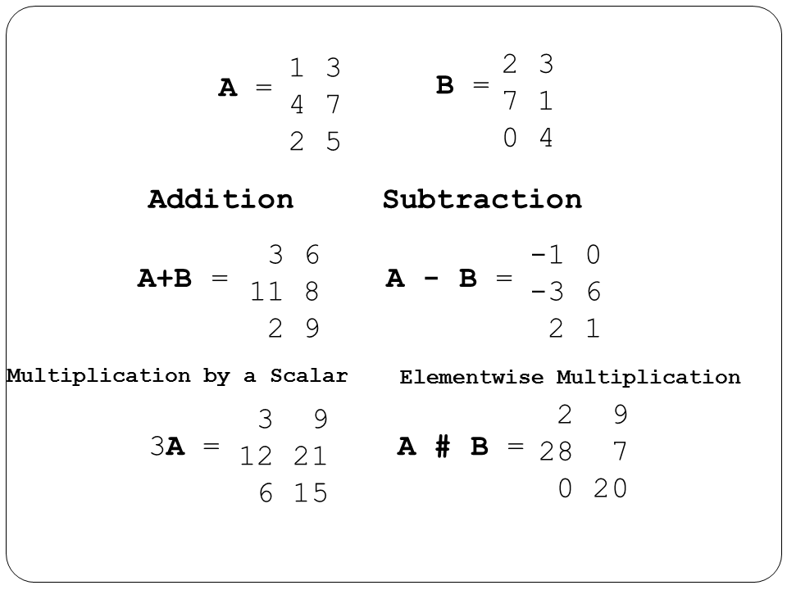
What is a matrix?
A matrix a rectangular array of numbers arranged in rows and columns
  The main advantage of matrices is that you can do simple mathematical operations on them
    Addition
    Multiplication
    Subtraction

Slide 18
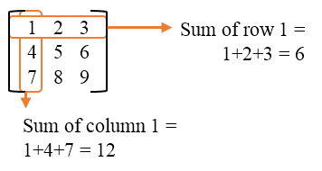
What is a matrix?
A matrix a rectangular array of numbers arranged in rows and columns
  The main advantage of matrices is that you can do simple mathematical operations on them
    Row sums
    Column sums
  This creates measures of graph theoretic concepts!

Slide 19
The social network analysis three-step shuffle
Think up or grab an “off the shelf” fuzzy concept from social science to develop a network-theoretic concept
(e.g. popularity, brokerage, reciprocity, role, status)
Translate the concept from natural language to the “language” of graph theory to develop a graph-theoretic concept
(e.g. points and lines)
Link the graph-theoretic concept to matrix algebra to develop a network-analytic measure of the network-theoretic concept
(e.g. indegree centrality as a measure of popularity)

Slide 20
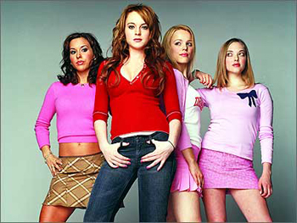
The network theory three-step shuffle: Example
How can we specify the social science concept of popularity In network terms ?
  Step 1: Define the concept in natural language network-theoretic terms:
    “A person who is well known among her peers”

Slide 21
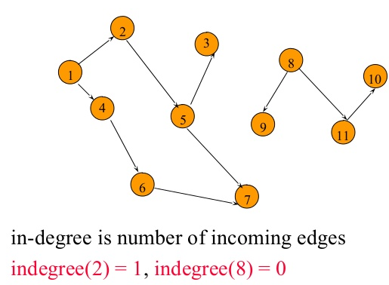
The network theory three-step shuffle: Example
How can we specify the social science concept of popularity In network terms ?
  Step 2: Translate the concept from natural language to the “language” of graph theory to develop a graph-theoretic concept:
    “Indegree”: Number of incident edges on a vertex in a directed graph

Slide 22
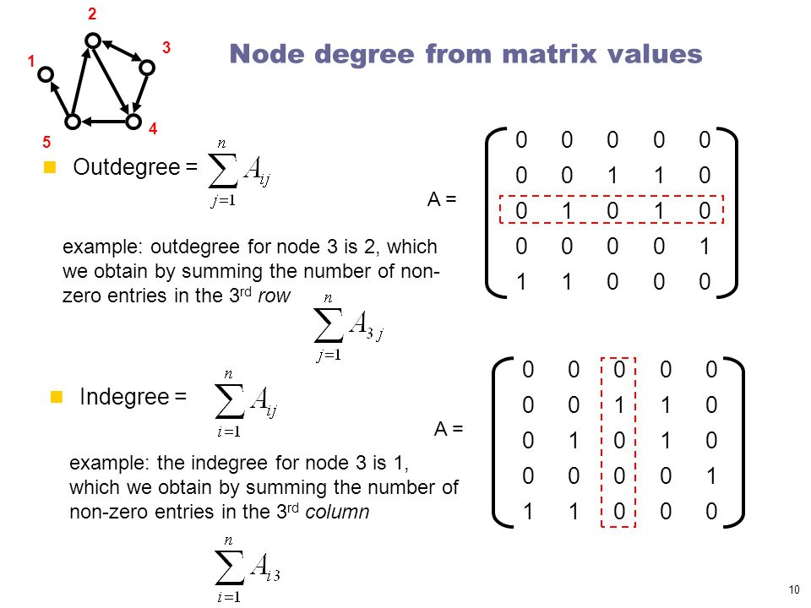
The network theory three-step shuffle: Example
How can we measure the social science concept of popularity In network terms ?
  Step 3: Link the graph-theoretic concept to a matrix representation and perform a mathematical operation:
    “The indegree of node 3 is 1, which we can obtain by summing the number of nonzero entries in the 3rd column of the matrix”

Slide 23
Three ways of talking about “social networks"
Terms used to refer to "real life" states or processes in a social system
  Reciprocity in social relations
  The "popularity" or "expansiveness" of an actor's social relations
Terms used to refer to the graph-theoretic concept that is the analogue of that state or process
  The presence of directed edge (arc) joining two vertices
  The cardinality of the set of edges terminating or originating at at a given vertex
Terms used to the matrix algebraic representation of the graph-theoretic analogue of that state or process
  Whether the product a_{ij} X a_{ji} in the adjacency matrix is 1 (reciprocity) or 0 (non-reciprocity)
  The sum Σ_{j}a_{ij} (outdegree) or the sum Σ_{i}a_{ij} (indegree) in the adjacency matrix
    Don’t Confuse them!

Slide 24
Graph theory: Representing network concepts
“Simple” (binary, undirected) graphs can represent some social network concepts:
  E.g. “having a tie,” “having lots of connections,” “being a broker between two people”
But not all
  E.g. “Reciprocity” can only be represented in a directed graph
The representation of other social network concepts require other types of graphs:
  For instance, “having ties of different strengths” can only be represented by a graph with non-binary values

Slide 25

Weighted graphs
Often it is useful to associate numerical values with the edges (uv) of a graph:
  This is called the edge weight (w_{uv})
  This may be used to represent:
    the strength of the relationship joining two people
    the amount of something (e.g. information) that flows via the ties
Graphs that featured edge weights are called weighted (valued) graphs:
  Binary graphs can be thought of as a constrained case of weighted graphs

Slide 26
Weighted graphs
Often it is useful to associate numerical values with the edges (uv) of a graph:
  This is called the edge weight (w_{uv})
  This may be used to represent:
    the strength of the relationship joining two people
    the amount of something (e.g. information) that flows via the ties
Sometimes people “binarize” weighted graphs using a cutoff to simplify analysis
  a_{ij} = 1 if w_{ij} > ϴ, else a_{ij} = 0

Slide 27
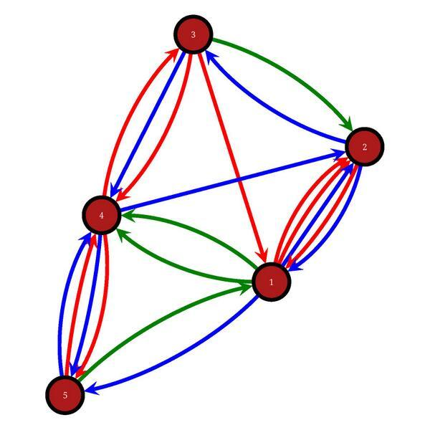
Multigraphs
In both directed and undirected graphs, the same vertices may be joined by more than one distinct edge
  These are called multigraphs
Multigraphs may be used to represent the social network concept of multiplexity
Multiplexity exist when persons have multiple relations relationships with one another
    e.g. a friend who is also an advisor who is also a member of your congregation

Slide 28
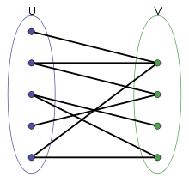
Bipartite graphs
A bipartite graph is characterized by:
  Two disjoint sets of vertices.
  Edges link vertices between sets but not within sets
Bipartite graphs can be used to represent the social network concepts of affiliation or membership
  In Affiliation networks people are linked to other entities that are not people
    Actors and movies
    Scientists and papers
    Persons and events

Slide 29
Some graph theoretic concepts: Degree
The degree of a vertex d(v) in an undirected graph is the number of edges that have v as their destination (origin) vertex
  The set of neighbors of v is denoted N(v)
  In a directed graph the outdegree of vertex v d^{out}(v) is the number of edges that originate in v
  In a directed graph the indegree of vertex d^{in}(v) is the number of edges that terminate in v
  Degree may be considered an index of a node's centrality
A variety of graph properties are derived from vertex degree
  Mean degree = Σ_{i}d(v_{i})/N = 2M/N
  Graph Density = M/[N(N-1)/2] = 2M/[N(N-1)] = D/N-1

Slide 30
Some graph theoretic concepts: Degree
The degree of a vertex d(v) in an undirected graph is the number of edges that have v as their destination (origin) vertex
  The set of neighbors of v is denoted N(v)
  In a directed graph the outdegree of vertex v d^{out}(v) is the number of edges that originate in v
  In a directed graph the indegree of vertex d^{in}(v) is the number of edges that terminate in v
  Degree may be considered an index of a node's centrality
We have seen that the graph theoretic concept of degree maps onto important social network concepts
  Gregariousness (Isolation)
  Popularity (Unpopularity)

Slide 31
Some graph theoretic concepts: Subgraphs
A graph G' = (V', E') is a subgraph of a graph G iff:
  V' is a subset of V and E' is a subset of E
Subgraphs may induced by either:
  Sampling a group of vertices and the selecting the subset of edges that link them
  Sampling a group of edges and the selecting of the vertices that are the destination (origin) of each edge.
A lot of network methods are designed to split a graph into subgraphs
  Subgraphs can be used to represent the social network concepts of groups, cliques, or communities

Slide 32
Walks, Trails, Paths
A walk is an alternating sequence of vertices and edges {u₁, e₁₂, u₂, e₂₃, u₃....u_{n}} starting with an origin vertex u₁ ending with a destination vertex u_{n} such that:
  Each vertex in the sequence (excluding the origin and destination vertices) is adjacent to the vertex the precedes it and the vertex that follows it
The length of the walk is the number of edges contained in the sequence
  A walk is called a path if all edges and all vertices appear only once in the sequence
Graph-theoretic paths can be used to represent the social network concept of “n-degrees of separation” between people
  In particular, we may be interested in the length of the shortest path (L > 1) linking two people

Slide 33
Walks, Trails, Paths
A walk is an alternating sequence of vertices and edges {u₁, e₁₂, u₂, e₂₃, u₃....u_{n}} starting with an origin vertex u₁ ending with a destination vertex u_{n} such that:
  Each vertex in the sequence (excluding the origin and destination vertices) is adjacent to the vertex the precedes it and the vertex that follows it
The length of the walk is the number of edges contained in the sequence
  A walk is called a path if all edges and all vertices appear only once in the sequence
We may also be interested in the average length of the shortest paths (also called geodesics) linking each pair of vertices in a graph
  When this is smaller than we would expect (e.g. “6”) this quantity can be used to represent the social network concept of a “small world”

Slide 34
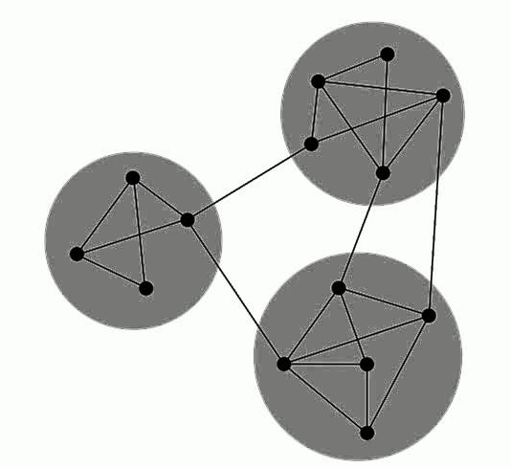
Graph connectivity
A graph is connected if there exists a (finite) path between each vertex
  Otherwise the graph is disconnected
A maximal connected subgraph is called a component
  In a graph, the connected subgraph that contains the largest proportion of vertices is called the giant component

Slide 35
Graph connectivity
A graph is connected if there exists a (finite) path between each vertex
  Otherwise the graph is disconnected
A maximal connected subgraph is called a component
  In a graph, the connected subgraph that contains the largest proportion of vertices is called the giant component
Oops! Disconnected!

Slide 36
Graph connectivity
A graph is connected if there exists a (finite) path between each vertex
  Otherwise the graph is disconnected
A maximal connected subgraph is called a component
  In a graph, the connected subgraph that contains the largest proportion of vertices is called the giant component

Slide 37
Graph connectivity
A graph is connected if there exists a (finite) path between each vertex
  Otherwise the graph is disconnected
A maximal connected subgraph is called a component
  In a graph, the connected subgraph that contains the largest proportion of vertices is called the giant component

Slide 38
Graph connectivity
Some graphs are easy to disconnect
  Only require the removal of a few links
Others are hard to disconnect
  Requires the removal of a lot of link
The number of edges whose removal is required to disconnect a graph can represent the social network concept of social integration
  This is called the cutset

Slide 39
Graph connectivity
Some graphs are easy to disconnect
  Only require the removal of a few links
Others are hard to disconnect
  Requires the removal of a lot of link
The higher the cutset the more integrated the social network
The lower the cutset the more potentially fragmented the social structure is

